Slide 1
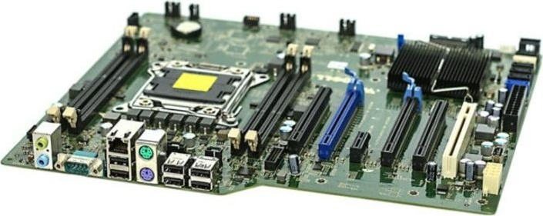
Hardware 1
Y12 - Cambridge International 9618 | 3.1
1
Notes:
First lesson on 3.1 Computers and their components. Covers: the need for input, output, primary memory and secondary storage; RAM and ROM; SRAM and DRAM; PROM, EPROM and EEPROM; embedded systems (benefits and drawbacks). Next lessons in 3.1: secondary storage devices and buffers (magnetic hard disk, solid state, optical), then input and output devices (laser printer, 3D printer, microphone, speakers, touchscreen, VR headset) and ADC / DAC.
Suggested 60-minute pacing (also on slide 19):
0-5 starter (Task 1)
5-15 memory and storage, RAM, ROM (slides 4-8)
15-22 DRAM and SRAM (slides 9-10) + Task 2
22-32 PROM, EPROM, EEPROM (slides 11-12) + Task 3
32-47 embedded systems (slides 13-16) + Task 4
47-55 exam focus (slides 17-18), start Task 5
55-60 exit question.
Task 5 (real Paper 1 questions) is homework. Photo credits are on the last slide.

Slide 2
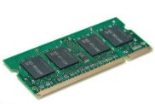
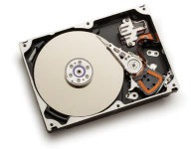
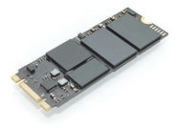
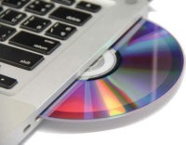
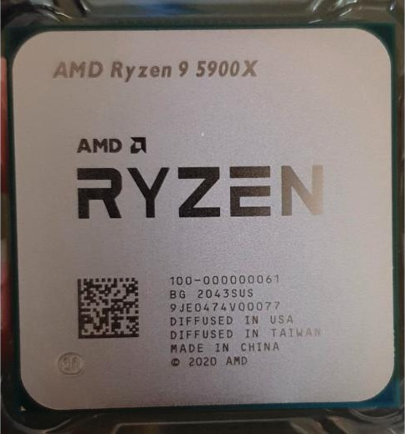
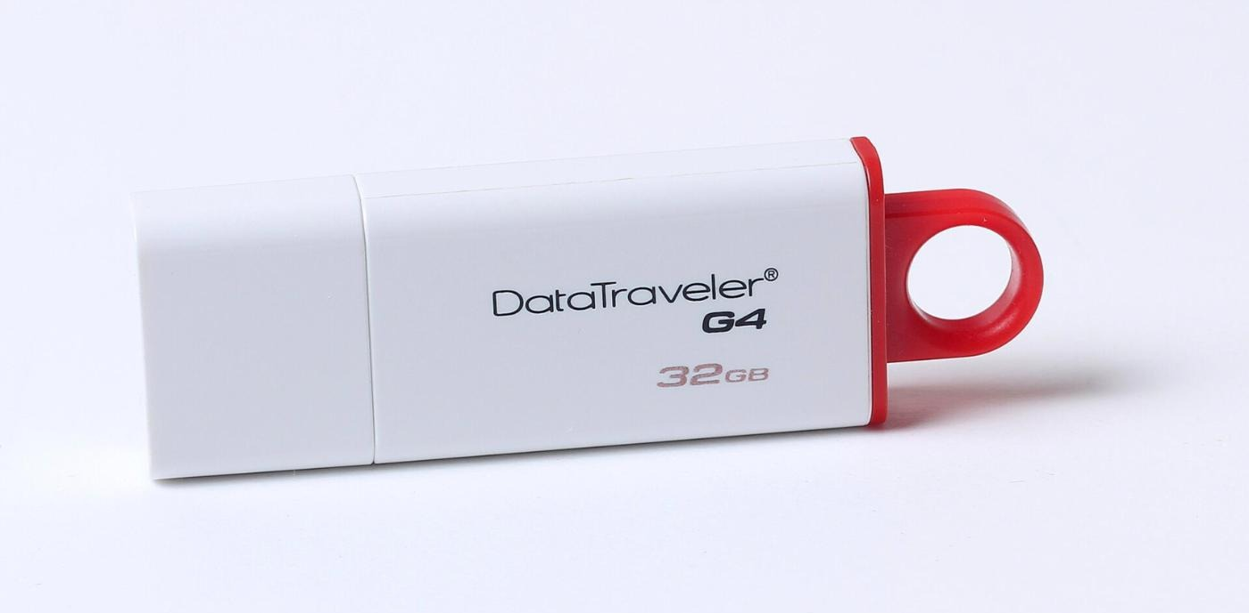
Starter: memory or storage?
Starter activity
A
B
C
D
E
F
Name each one. Is it primary memory, secondary storage, or neither?
2
Notes:
Worksheet Task 1, 5 minutes. Students name each component and say whether it is primary memory, secondary storage or neither. Answers: A RAM module - primary memory. B hard disk drive (HDD), opened up - secondary storage. C solid state drive (SSD, M.2) - secondary storage. D optical disc (CD / DVD) in a laptop drive - secondary storage, removable. E USB flash drive - secondary storage, removable. F processor (CPU) - neither, but it contains registers and cache, the fastest memory. Use F to start the discussion on slide 4.

Slide 3
In this lesson, you will
Objectives
Explain why a computer needs input, output, primary memory and secondary storage
Explain the differences between RAM and ROM, and where each is used
Explain the differences between SRAM and DRAM, and where each is used
Explain the differences between PROM, EPROM and EEPROM
Describe embedded systems, with their benefits and drawbacks
3

Slide 4
What does a computer need?
Activity 1
on the motherboard
Why?
Processor (CPU)
Input: data in
Output: results out
Primary memory: the CPU can only use data held here
Secondary storage: keeps files when power is off, in large amounts
Input
devices
Output
devices
Primary memory
RAM + ROM
Secondary storage
HDD, SSD, optical, flash
4
Notes:
The syllabus asks why each is needed. Input devices get data into the computer; output devices give results to the user (or to other devices). The processor can only work on data and instructions held in primary memory, which it accesses directly - so programs are loaded from secondary storage into RAM before they run. Primary memory (RAM) is volatile and limited in size, so secondary storage is needed to keep programs and files permanently and in large amounts. Removable storage lets data be moved between computers or kept as a backup in a different place.

Slide 5
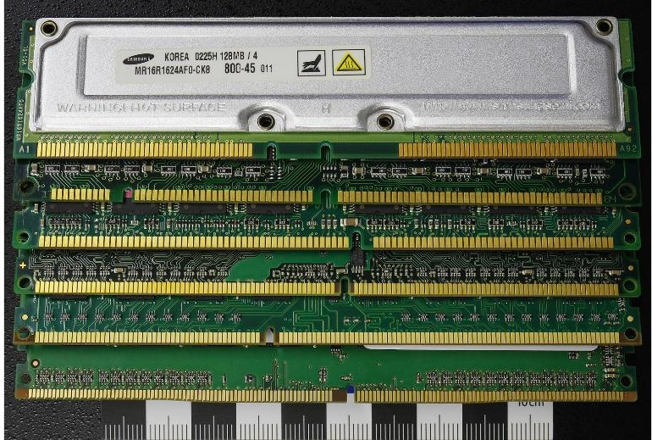
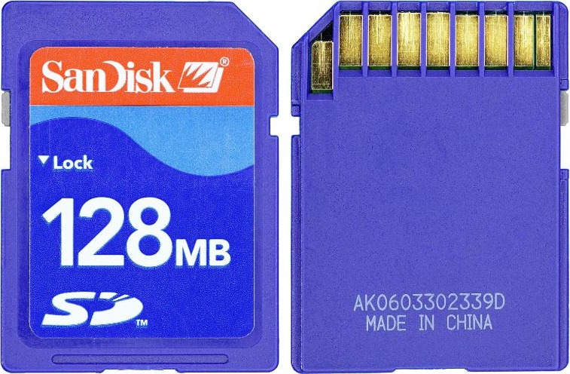
Primary memory and secondary storage
Activity 1
 | Primary memory | Secondary storage
Accessed by the CPU | Directly | Not directly: loaded into RAM first
Volatile? | RAM: yes ROM: no | No - kept without power
Size and speed | Small, very fast | Large, much slower
Examples | RAM, ROM (also cache, registers) | HDD, SSD, optical disc, flash drive
RAM modules
Hard disk
Removable storage
Flash drive
Memory card
Flash drives, memory cards, optical discs and external hard disks can be moved between computers, or kept in another building as a backup.
Primary memory (top left), secondary storage (the rest)
5
Notes:
Primary memory is accessed directly by the processor; it holds the programs and data in use now (RAM) and the start-up instructions (ROM). It is fast but small and RAM is volatile. Secondary storage is not directly accessible by the CPU: data must be loaded into RAM first. It is non-volatile, much larger and much slower. Removable secondary storage (USB flash drives, memory cards, optical discs, external HDDs) can be moved between computers or used for backups.

Slide 6
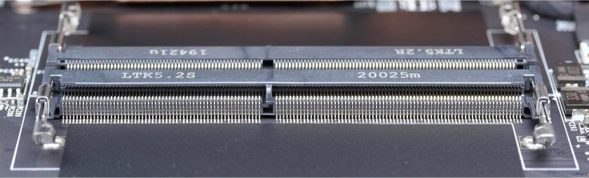
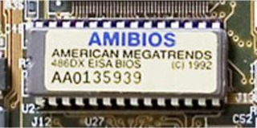
Types of primary memory
Activity 2
Primary memory
RAM
ROM
RAM slots on a motherboard
SRAM
DRAM
PROM
EPROM
EEPROM
read and write, volatile
read only in normal use, non-volatile
incl. flash
ROM chip holding the BIOS
6
Notes:
Figure 3.3 in the textbook. Primary memory is made of RAM and ROM chips. RAM comes in two technologies, DRAM and SRAM. ROM comes in several kinds; PROM, EPROM and EEPROM can be programmed after the chip is made. Flash memory (USB drives, SSDs, memory cards) is a type of EEPROM. Leave this slide up while students work through the next few slides.

Slide 7
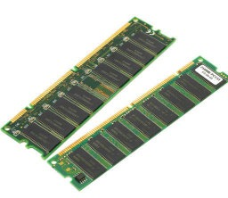
Random access memory (RAM)
Activity 2
RAM
Can be read from and written to
Holds the data, files, programs and parts of the OS in use now
Volatile: contents are lost when the power is off
Any location can be accessed directly (random access)
RAM modules (DRAM)
Why does more RAM make a computer faster?
When RAM is full, data is swapped out to slow secondary storage and read back later. More RAM means less swapping.
RAM slots beside the processor socket
7
Notes:
Random access: any location can be read directly, in the same time, whatever location was used last - not that data is stored randomly. RAM can be read from and written to; it holds the data, files, parts of applications and parts of the operating system currently in use; it is volatile. Why more RAM speeds a computer up: when RAM is full, data has to be swapped out to (much slower) secondary storage and read back in; more RAM means less swapping. The processor itself is not faster.

Slide 8
Read-only memory (ROM)
Activity 2
RAM | ROM
Temporary memory | Permanent memory
Volatile | Non-volatile
Can be read from and written to | Can only be read in normal use
Holds data and programs in use now | Holds the BIOS / start-up instructions, firmware
Adding more can improve performance | Size is fixed by the manufacturer
BIOS ROM chip on a motherboard
Bootstrap
At power-on, RAM is empty. The start-up instructions in ROM load the operating system from secondary storage into RAM.
8
Notes:
ROM is also random access but cannot be written to in normal use. It is non-volatile, so it keeps the start-up instructions (bootstrap / BIOS) that the computer needs before anything is loaded from secondary storage. In embedded systems it holds the firmware - the program that runs the device. Mark-scheme wording (9618/12 N22): ROM stores data that does not change; data must be kept without power; it stores boot-up instructions / firmware / BIOS.

Slide 9
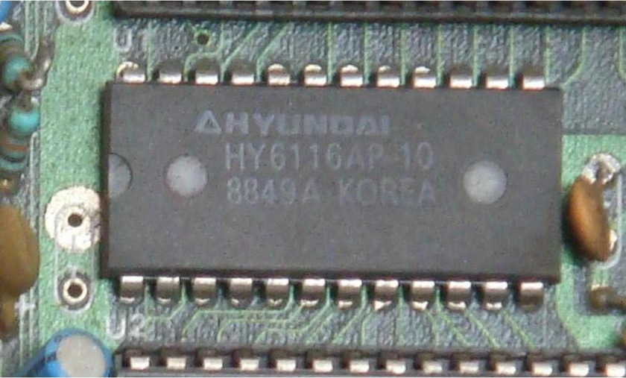
Dynamic RAM and static RAM
Activity 3
 | DRAM (dynamic) | SRAM (static)
Stores each bit with | A capacitor and a transistor | A flip-flop (several transistors)
Refreshing | Needed constantly | Not needed
Access speed | Slower | Faster
Cost and capacity | Cheaper; more data per chip | More expensive; less per chip
Used for | Main memory | Cache memory
DRAM modules
An SRAM chip
Dynamic = must be refreshed. Static = keeps its value while powered.
9
Notes:
DRAM: each bit is stored as charge on a capacitor, with a transistor acting as a switch to read or change it. The charge leaks away, so it must be refreshed (recharged) about every 15 microseconds. One transistor and one capacitor per bit - simple, so many bits fit on a chip: cheaper, higher capacity (density). SRAM: each bit is held by a flip-flop (about 6 transistors) - no refreshing, faster access (textbook: about 25 ns compared with 60 ns), but more transistors per bit, so it is more expensive and holds less per chip. Power: DRAM uses power to refresh; SRAM can use more than DRAM when accessed very often (mark schemes accept "DRAM consumes less power" in some contexts - use the textbook comparison).

Slide 10
Where are DRAM and SRAM used?
Activity 3
Registers
inside the CPU
faster
Cache (SRAM)
in or next to the CPU
Main memory (DRAM)
RAM modules
Processor with SRAM cache
Secondary storage
HDD, SSD, flash, optical
bigger, cheaper per bit
Main memory: DRAM
10
Notes:
Memory hierarchy: the closer to the processor, the faster, smaller and more expensive per bit. Cache is SRAM because speed matters most and only a small amount is needed; main memory is DRAM because a large, cheap memory is needed and refresh delays are acceptable. Exam questions often give a device and ask why DRAM was chosen - answer in context: cheaper per unit, higher density, and the device does not need the fastest access (e.g. a 3D printer buffering print data, 9618/11 N23 Q7(c)). Worksheet Task 2 now.

Slide 11
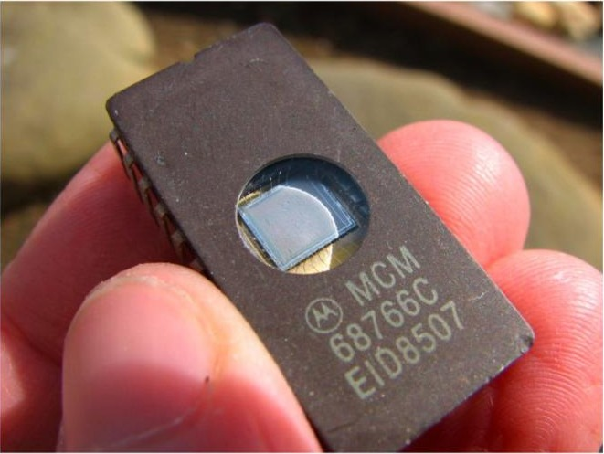
PROM, EPROM and EEPROM
Activity 4
PROM
EPROM
EEPROM
fuses: blown (red) = 0, intact = 1
Programmable ROM
Fuses are burnt by a PROM writer
Written once only
Cannot be erased
Erasable PROM
Erased by UV light through a quartz window
Removed from the circuit; whole chip erased
Can be reprogrammed
Electrically erasable PROM
Erased by an electrical signal, in the circuit
Can erase single bytes
Rewritten many times; flash memory is a type
11
Notes:
All three are kinds of ROM that can be programmed after manufacture. PROM: a matrix of fuses; a PROM writer burns (blows) fuses with an electric current, so it can be written only once (textbook examples: mobile phones, RFID tags). EPROM: uses floating-gate transistors; erased by shining ultraviolet light through the quartz window, which erases the whole chip, and the chip must be removed from the circuit; then it can be reprogrammed - used for devices under development. EEPROM: erased and rewritten electrically, while still in the circuit, a byte at a time if needed, many times - so firmware can be updated by the user (e.g. a BIOS or TV update). Flash memory is a type of EEPROM that erases in blocks.

Slide 12
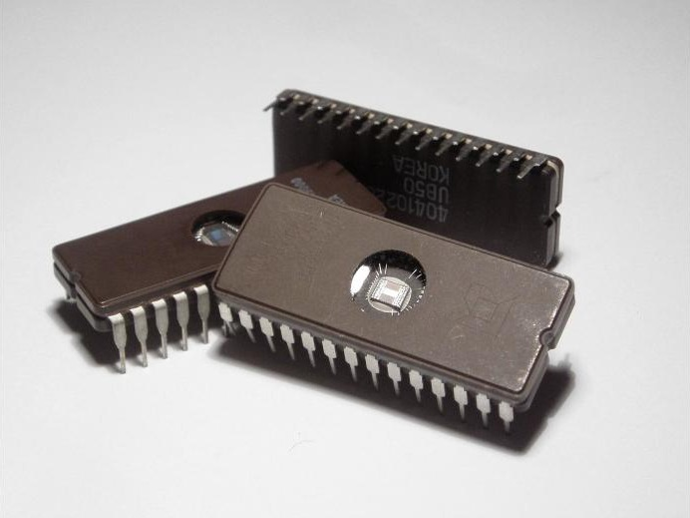
EPROM or EEPROM?
Activity 4
 | EPROM | EEPROM
Erased by | Ultraviolet light | An electrical signal
Where | Removed from the circuit board | Stays in the circuit
How much | The whole chip | A single byte or the whole chip
Typical use | Devices under development | Firmware that the user can update
EPROMs: the quartz window lets UV light reach the chip
Why put EEPROM in a device?
Its firmware can be updated many times, without removing the chip and without specialist equipment - even by the user.
12
Notes:
A common exam comparison (9618/12 N24 Q2(c) is in Task 5). EEPROM benefits in a device: firmware can be updated without removing the chip, without specialist equipment, by a non-technical user, and particular bytes can be changed. Worksheet Task 3 now.

Slide 13
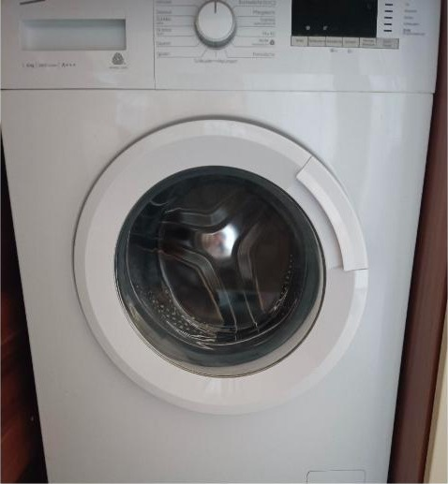

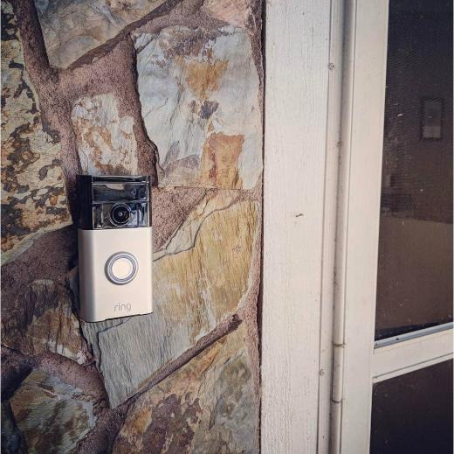
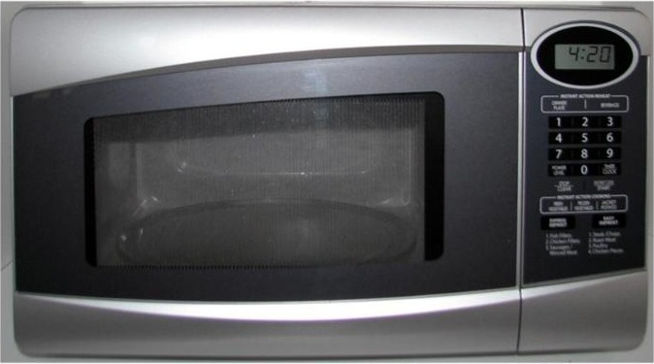
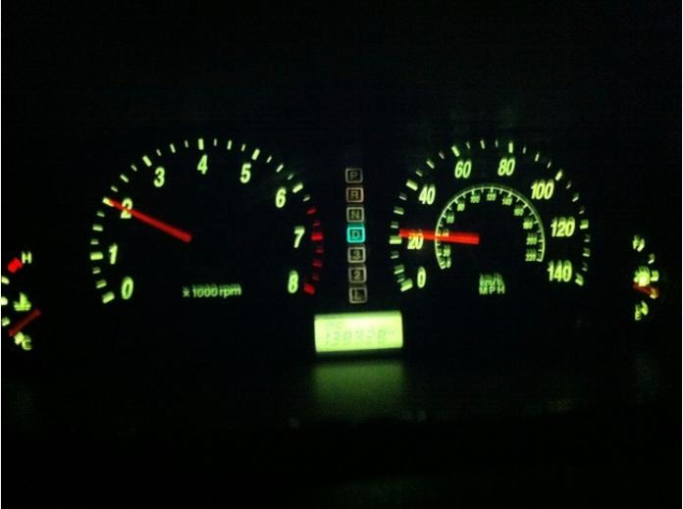
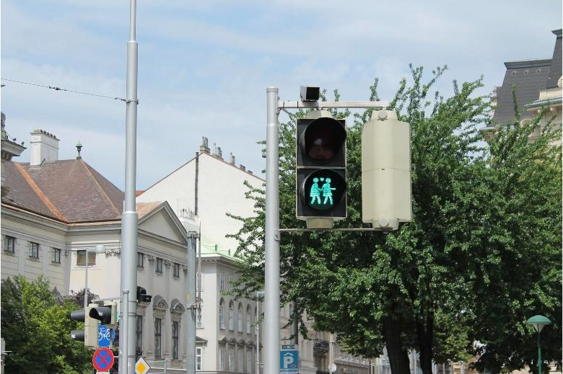
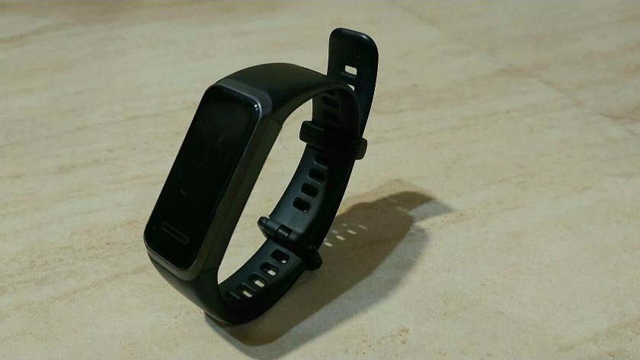
Embedded systems
Activity 5
Microwave oven
Washing machine
Smart thermostat
Video doorbell
Embedded system
A processor, memory and I/O built into a larger device, dedicated to one task.
Traffic lights
Fitness band
Car dashboard
13
Notes:
An embedded system is a microprocessor or microcontroller (with its own memory and input / output) built into a larger device and dedicated to one task. It runs firmware stored in ROM / EEPROM / flash, usually with no general-purpose operating system, and the user cannot install other programs. Mark-scheme wording (9618/12 N23 Q1(c)): dedicated to a single task / limited number of functions; built into a larger system; must contain a processor, memory and I/O capability. Ask: which of these are embedded systems? (All of them.) What does each one control?

Slide 14
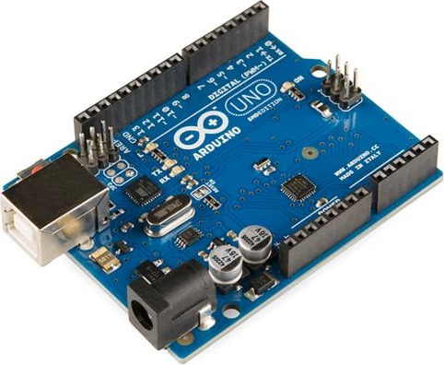
Inside an embedded system
Activity 5
1
Processor
runs the firmware; does one job
2
ROM / EEPROM / flash
firmware: the program that runs the device
3
RAM
current settings, sensor readings, timers
A microcontroller board used to build embedded systems
Dedicated to one task, built into a larger device, no general-purpose OS.
4
Input / output
sensors, buttons, display, motors
14
Notes:
A microcontroller puts a processor, RAM, ROM (flash / EEPROM) and input / output pins on one chip; a board like the Arduino Uno is used to prototype embedded systems. The firmware in ROM runs the device as soon as it is powered; RAM holds the current settings, sensor readings and timers. It reacts in real time to its inputs. It does not need much processing power - only a dedicated processor for the task.

Slide 15
Benefits and drawbacks of embedded systems
Activity 5
Benefits | Drawbacks
Small, so easy to fit into a device | Difficult to upgrade or update the firmware
Cheap to make in large numbers | Fault-finding and repair is a specialist task
Dedicated to one task: simple interface, no OS needed | Cannot easily be adapted for another task
Use very little power | Often thrown away rather than repaired: e-waste
React quickly to inputs (real time) | Devices on the internet can be hacked
Mass production makes them reliable | A "simple" interface can be confusing (e.g. setting a clock)
Controlled from a phone app
Small, low power
15
Notes:
From textbook Table 3.3 and recent mark schemes (9618/12 N24 Q2(a) asks for drawbacks - in Task 5). Drawbacks examiners credit: firmware difficult for the user to change / update; faults hard to fix - repair is a specialist task; cannot easily be adapted for another task; devices thrown away rather than repaired - e-waste; internet-connected devices can be hacked.

Slide 16
Worked example: RAM and ROM in a microwave
Activity 5
ROM holds
The firmware that controls the oven
Start-up instructions
Built-in cooking programs (defrost, popcorn ...)
RAM holds
Microwave oven with keypad and display
The time and power level the user enters
The time left in the countdown
Current readings, e.g. whether the door is open
Always say what the memory holds in THIS device.
16
Notes:
Based on textbook Extension activity 3A. Model the answer style: say what each memory holds IN THIS DEVICE. ROM (non-volatile): the firmware - the program that runs the oven, the start-up instructions, the stored cooking programs (e.g. defrost settings). RAM (volatile): the time and power level the user keys in, the time left / countdown, the current state of the door switch and the clock. Then students do Task 4 for a smart thermostat.

Slide 17
Exam focus: embedded systems (Paper 1)
Exam focus
Question | Official marking points
9618/12 N23 Q1(c)(i) Two features [2] | Dedicated to a single task // limited number of functions; built into / integrated into a larger system; contains a processor, memory and an I/O capability // dedicated hardware
9618/12 N23 Q1(c)(ii) One drawback [1] | Difficult for the user to change / update the firmware; cannot be easily adapted for another task; troubleshooting / upgrading is a specialist task; often thrown away rather than repaired
9618/11 N22 Q9(a) Why is a TV embedded? [2] | Built into / integrated into the TV; combination of hardware and software designed for a specific function; not easily changed / updated by the TV owner
9618/11 N22 Q9(b) One benefit of EEPROM [2] | Can be erased and reprogrammed several times ... so firmware can be updated; no extra equipment needed ... updates by non-technical users; possible to update without removing it from the device
17
Notes:
Two real questions with their official mark schemes. 9618/12 Oct/Nov 2023 Q1(c): (i) identify two features of embedded systems [2]; (ii) identify one drawback [1]. 9618/11 Oct/Nov 2022 Q9: (a) explain why modern televisions are embedded systems [2]; (b) describe one benefit of using EEPROMs in an embedded system [2]. Note how answers are applied to the device in the question.

Slide 18
Exam focus: choosing a type of RAM
Exam focus
9618/11 Oct/Nov 2023 Q7(c)
A 3D printer contains 1GB of Dynamic RAM (DRAM) to store print data. State two advantages of the printer having Dynamic RAM instead of Static RAM (SRAM). [2]
Official marking points (1 mark each, max 2)
Dynamic RAM has lower cost per unit
A fast access speed is not needed
Higher bit density // more data can be stored per chip
Compare in context: why is DRAM good enough for THIS device?
18
Notes:
9618/11 Oct/Nov 2023 Q7(c): "A 3D printer contains 1GB of Dynamic RAM (DRAM) to store print data. State two advantages of the printer having Dynamic RAM instead of Static RAM (SRAM)." [2]. Official points: DRAM has lower cost per unit; a fast access speed is not needed; higher bit density // more data can be stored per chip. Point out the context mark: "fast access speed is not needed" only makes sense for this device. Then start Task 5.

Slide 19
Guided practice and pacing
Activity 6
Time | Slides | Worksheet
0-5 min | 2 | Task 1 Starter: memory or storage?
5-15 min | 4-8 | Primary memory and secondary storage, RAM, ROM
15-22 min | 9-10 | DRAM and SRAM; Task 2 RAM, ROM, DRAM, SRAM
22-32 min | 11-12 | PROM, EPROM, EEPROM; Task 3
32-47 min | 13-16 | Embedded systems; Task 4
47-55 min | 17-18 | Exam focus; start Task 5
55-60 min | 21 | Exit question
Homework | - | Task 5 Real Paper 1 questions
Check your work against the answer key when your teacher shares it.
19
Notes:
Suggested 60-minute plan. If time is short, set Task 4(c) and Task 5 for homework.

Slide 20
Common misconceptions
Plenary
Misconception | Why it is wrong
RAM is a storage device | RAM is primary memory: it holds the data and programs in use now, and is volatile
Random access means data is stored in random places | Any location can be read directly, in the same time, wherever the last one was
ROM can never be changed | Normal ROM cannot be changed in use, but PROM can be written once and EPROM / EEPROM can be erased and rewritten
SRAM is faster, so all RAM should be SRAM | SRAM costs more, stores fewer bits per chip and can use more power; DRAM is used for main memory
Dynamic RAM is dynamic because its size changes | It must be refreshed (recharged) many times a second or its data leaks away
More RAM makes the processor faster | More RAM means less swapping data in and out of slower secondary storage
EPROM is erased electrically | EPROM is erased with UV light through a quartz window, out of the circuit, all at once. EEPROM is erased electrically
An embedded system is just a small computer | It is a processor, memory and I/O built into a larger device and dedicated to one task
20
Notes:
Ask students which they believed at the start.

Slide 21
Exit question
Plenary
On a sticky note or mini-whiteboard:
a
RAM and ROM
Give two differences between RAM and ROM. [2]
b
Cache memory
Explain why cache memory is made from SRAM and not DRAM. [1]
c
Embedded systems
Identify one drawback of embedded systems. [1]
21
Notes:
Model answers:
(a) Any two: RAM is volatile, ROM is non-volatile; RAM can be written to, ROM is read-only in normal use; RAM holds data / programs in use, ROM holds start-up instructions / firmware (1 each).
(b) SRAM has faster access times than DRAM / does not need refreshing, and only a small amount is needed so the higher cost is acceptable (1).
(c) Any one: difficult to update the firmware; repair is a specialist task; cannot easily be adapted for another task; often thrown away rather than repaired (1).

Slide 22
In this lesson, you
Summary
Explained why a computer needs input, output, primary memory and secondary storage
Compared RAM and ROM, and said what each holds
Compared DRAM and SRAM, and where each is used
Compared PROM, EPROM and EEPROM
Described embedded systems, with their benefits and drawbacks
Next: how secondary storage devices work, and buffers.
22
Notes:
Next lesson: secondary storage in detail - how a magnetic hard disk, solid state (flash) memory and an optical disc reader/writer work, and the use of buffers. After that: input and output devices and ADC / DAC.

Slide 23
Sources
Credits
Photos: Wikimedia Commons (title - author, licence)
Arduino Uno - R3 - SparkFun Electronics (CC BY 2.0)
AMI 486DX EISA BIOS 20051109 - Andrew Dunn (CC BY-SA 2.0)
AMD Ryzen 9 5900X by BugWarp 02 - BugWarp (CC0)
Car Dashboard at Night - ParentingPatch (CC BY-SA 3.0)
DDR 4 SO-DIMM RAM slot PNr°0837 - D-Kuru (CC BY-SA 4.0)
Ring video doorbell on stone - Robert Nelson (CC BY 2.0)
EPROM! in der Hand 20070124 - Windell Oskay (CC BY 2.0)
Microchips - Zephyris (CC BY-SA 3.0)
Microwave oven flashon - Wrightmt (Public domain)
Computer-motherboard - Marcin Wieclaw (pcsite.co.uk) (CC BY-SA 4.0)
DIMM IMGP5807 smial wp - smial (Free Art License)
SanDisk 128MB SD card - Mister rf (CC BY-SA 4.0)
Hyundai RAM HY6116AP-10 - Satyamfifa (Public domain)
Woman adjusts temperature on smart thermostat with remote control at home - Shixart1985 (CC BY 2.0)
Traffic Light, Vienna - John Samuel (CC BY-SA 4.0)
Kingston Technology DataTraveler G4 USB flash drive USB 3.0 32 Gb - Dmitry Makeev (CC BY-SA 4.0)
Washing-machine - Baruzza (CC BY-SA 4.0)
Huawei Smartwatch (Band 4) - TheArchivistMan (CC0)
Textbook
Watson, D. and Williams, H. Cambridge International AS & A Level Computer Science, Hodder Education, 2019, Chapter 3.1 (text; 5 photos: RAM, DRAM, SSD, hard disk, optical disc).
Exam questions
Cambridge International AS & A Level Computer Science 9618 question papers and mark schemes: 9618/11 June 2021, 9618/11 and /12 Oct/Nov 2022, 9618/11 June 2023, 9618/11 and /12 Oct/Nov 2023, 9618/11 and /12 June 2024, 9618/11 and /12 Oct/Nov 2024. (c) Cambridge University Press & Assessment.
23
Notes:
All photographs not from the textbook are from Wikimedia Commons, used under the licence shown. Exam questions are from Cambridge International AS & A Level Computer Science 9618 past papers and mark schemes.

